Slide 1



SpaceX Fan App
Murat Berke Türkan

Slide 2

What Did I Learn?
SwiftUI
Declarative Programming
State Management
Refactor

Slide 3

What Did I Learn?
Firebase Integration
Firebase Storage
Firebase Authentication
Firebase Firestore
Firebase Crashlytics

Slide 4

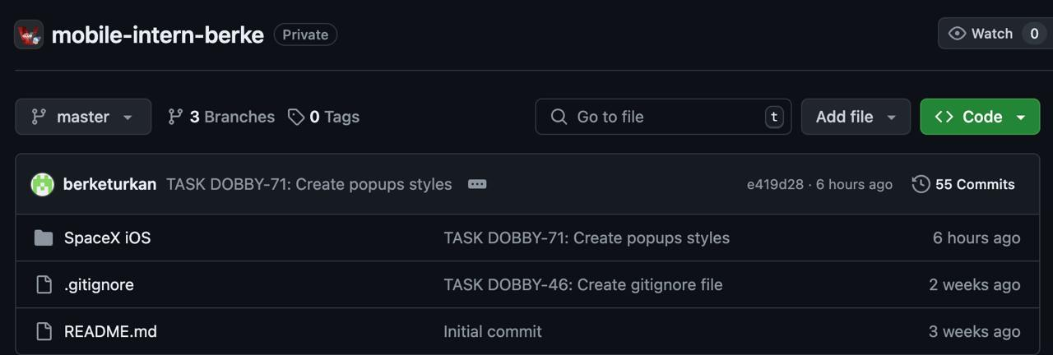
What Did I Learn?
GitHub
Committing Changes
Creating and Managing Pull Requests (PR)
Merging Branches

Slide 5

What Did I Learn?
JIRA
Effective Time Management
Scrum Methodology
Breaking Down Projects into Meaningful Tasks
Using Timesheets for Tracking
Managing Projects with Boards

Slide 6
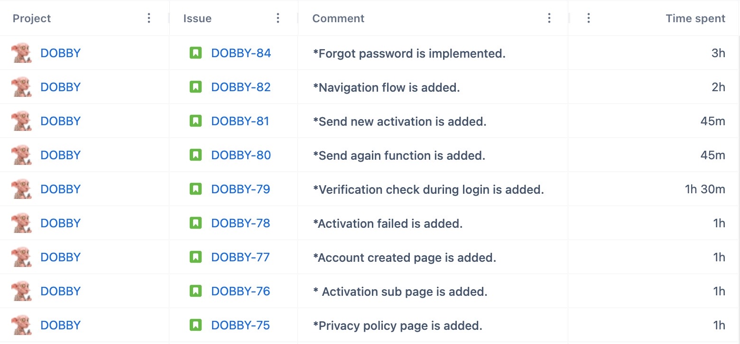
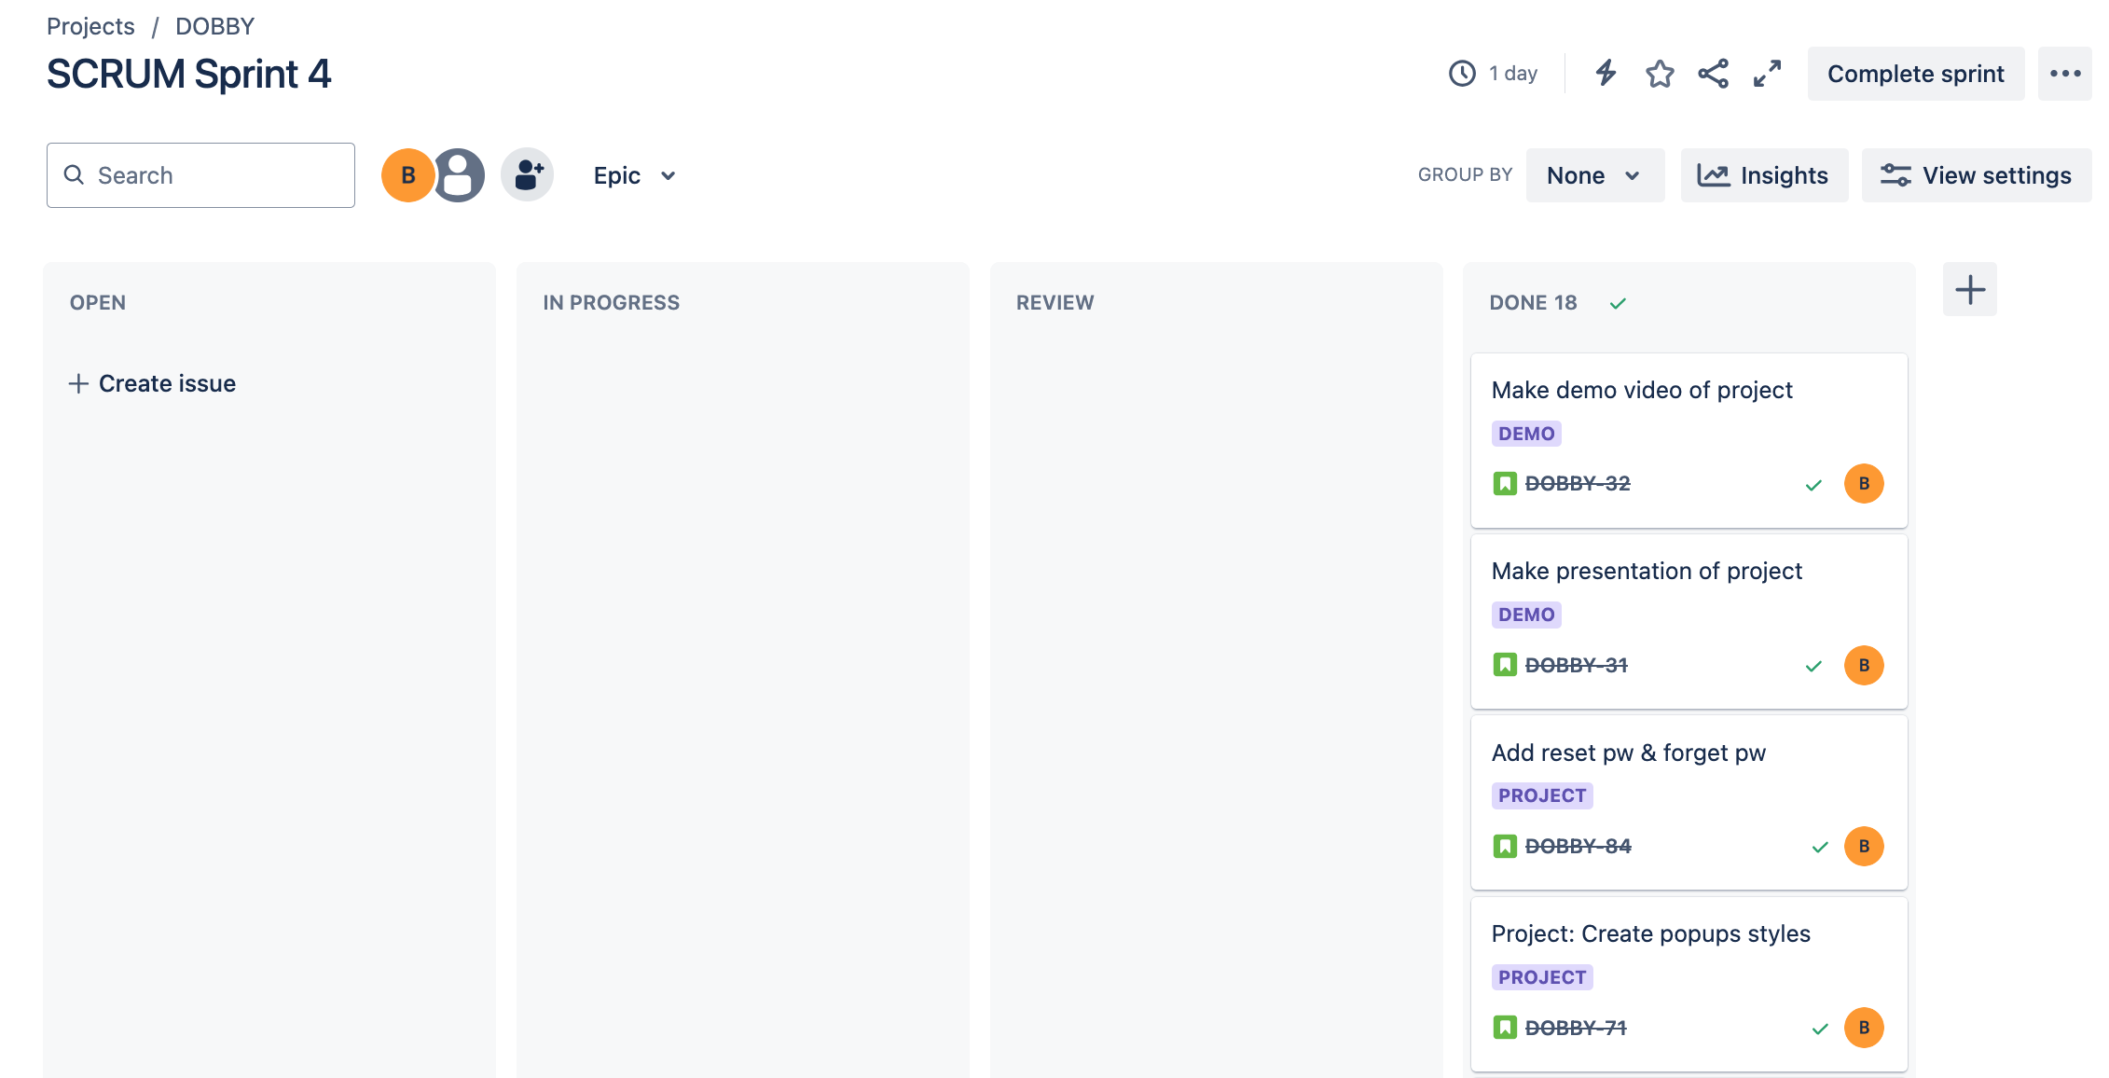
What Did I Learn?

Slide 7
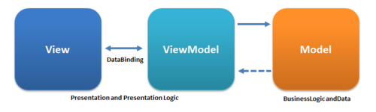
App Structure
Architecture
MVVM
Custom Component Structure
Database
Local: Realm
Remote: Firebase
Package Management
Pod
Swift Package Manager (SPM)

Slide 8
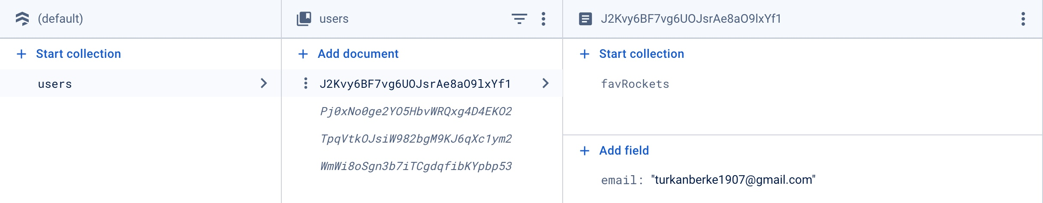
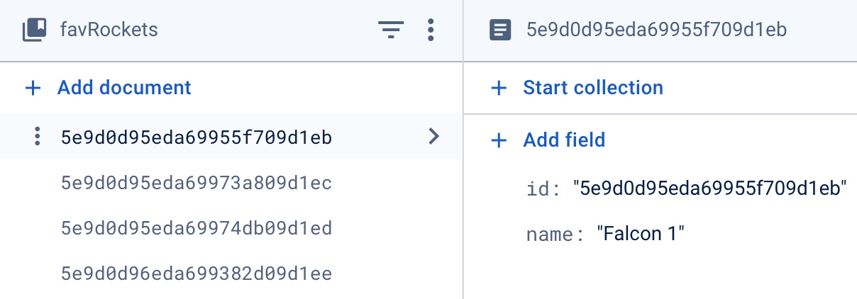
App Features
User Based Data Management
Firebase Firestore

Slide 9
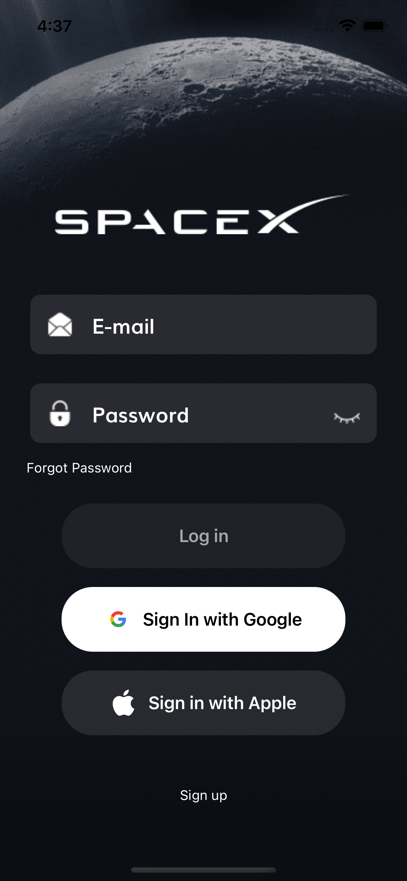
App Features
User Authentication
Google Sign-In
Sign Up & Log In
Forgot Password & Reset Password via activation e-mail

Slide 10
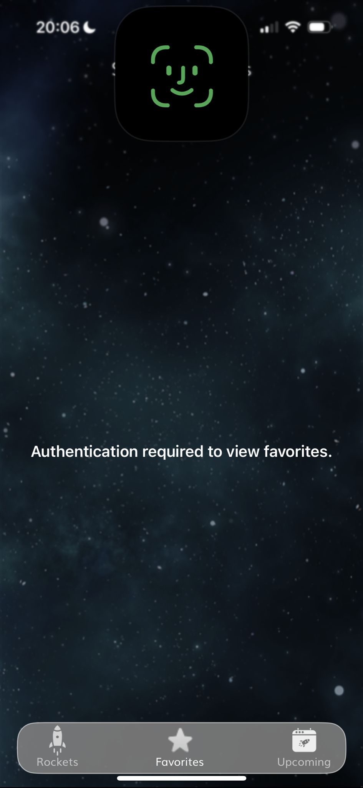
App Features
Favorites View
FaceID Authentication
Dynamic UI Display Based on User’s Favorite Rockets

Slide 11
What could be advanced?
Time Complexity
Efficient Management of Big Data
Implementation of Advanced Data Structures
Enhancing Computational Efficiency

Slide 12
What could be added?
Detailed Upcoming Launches
VPopup
Apple Sign In
Reset Password UI
Log out Button

Slide 13
Demo

Slide 14
Thank You

